Slide 1
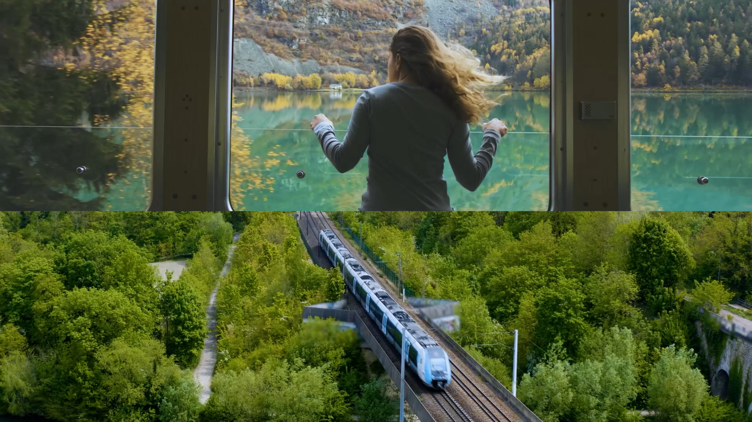

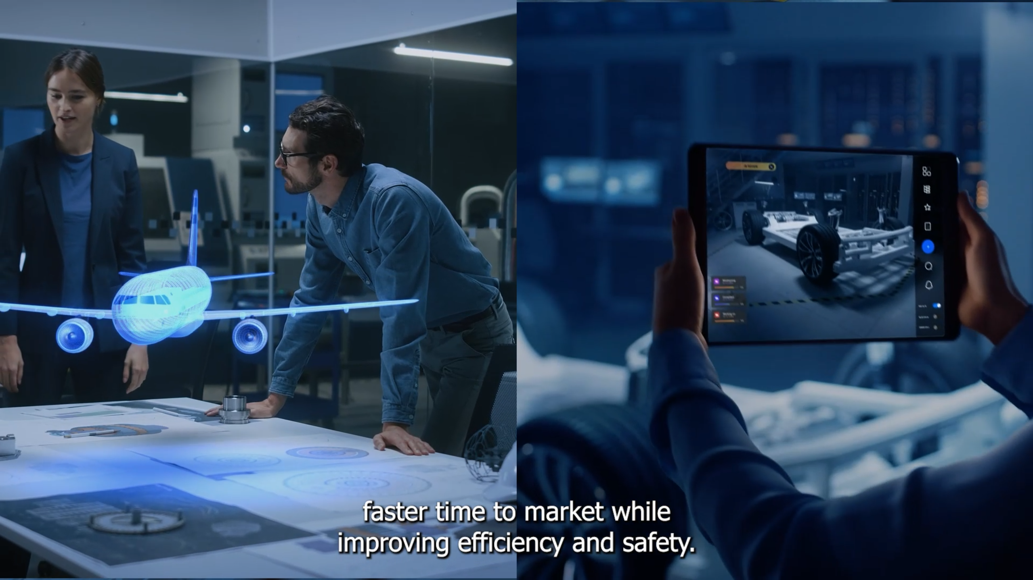
Microsoft AI for Mobility Sizzle
Microsoft wanted an innovative way to introduce its new cloud and AI-powered solutions for automotive, travel, transportation, and logistics. They turned to Affirma to create a short video to drive the message home.
Our Work
Worked closely with Microsoft to grasp the content, offer guidance, and formulate video production timelines for the video
Tweaked the provided script to match the client's goals and vision
Selected b-roll footage that aligned with Microsoft’s products and services for mobility solutions as well as communicated technological innovation in the mobility space
Finalized the video with engaging custom music, sound effects, and text animations
Provided closed-captions and audio descriptive files to be used with compatible video players meeting Microsoft’s Accessibility Conformance standards
The Result
The video now serves as an important tool in the Microsoft's Mobility Sales toolkit

Slide 2
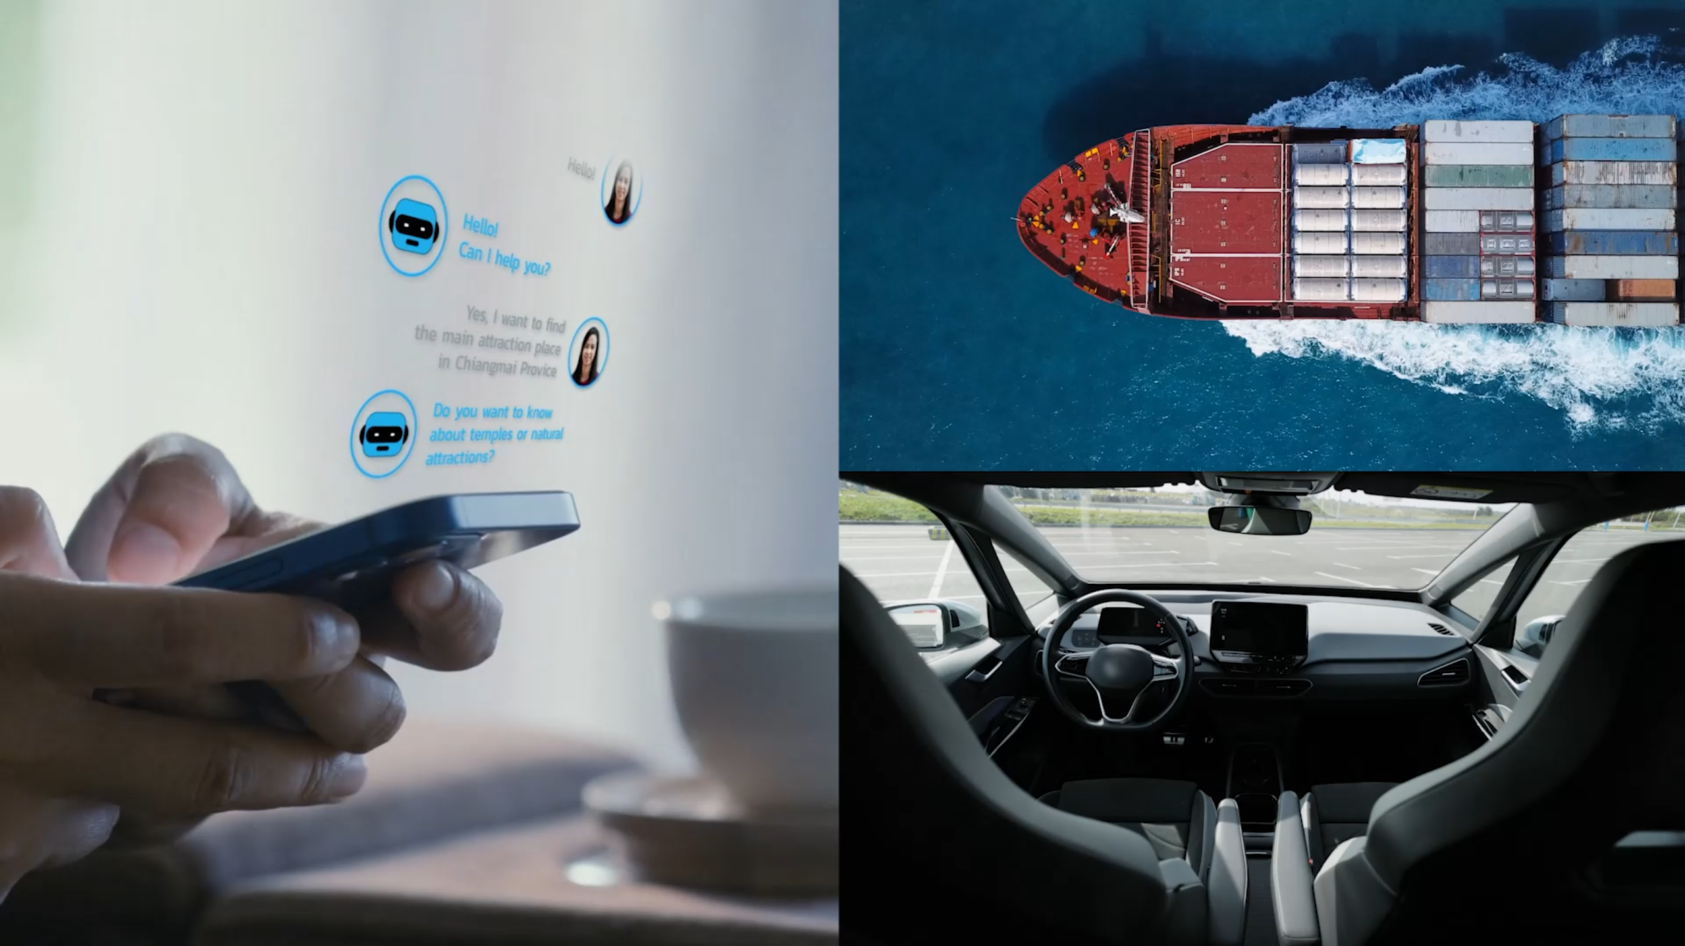
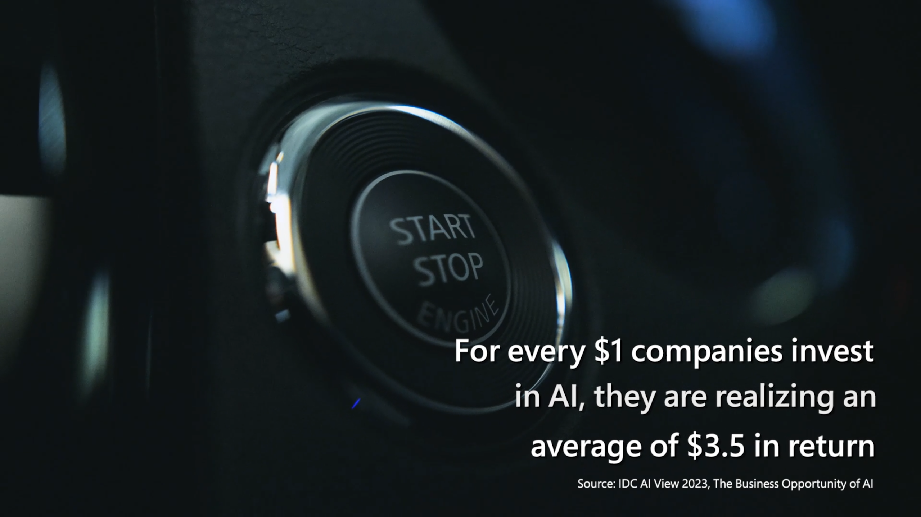
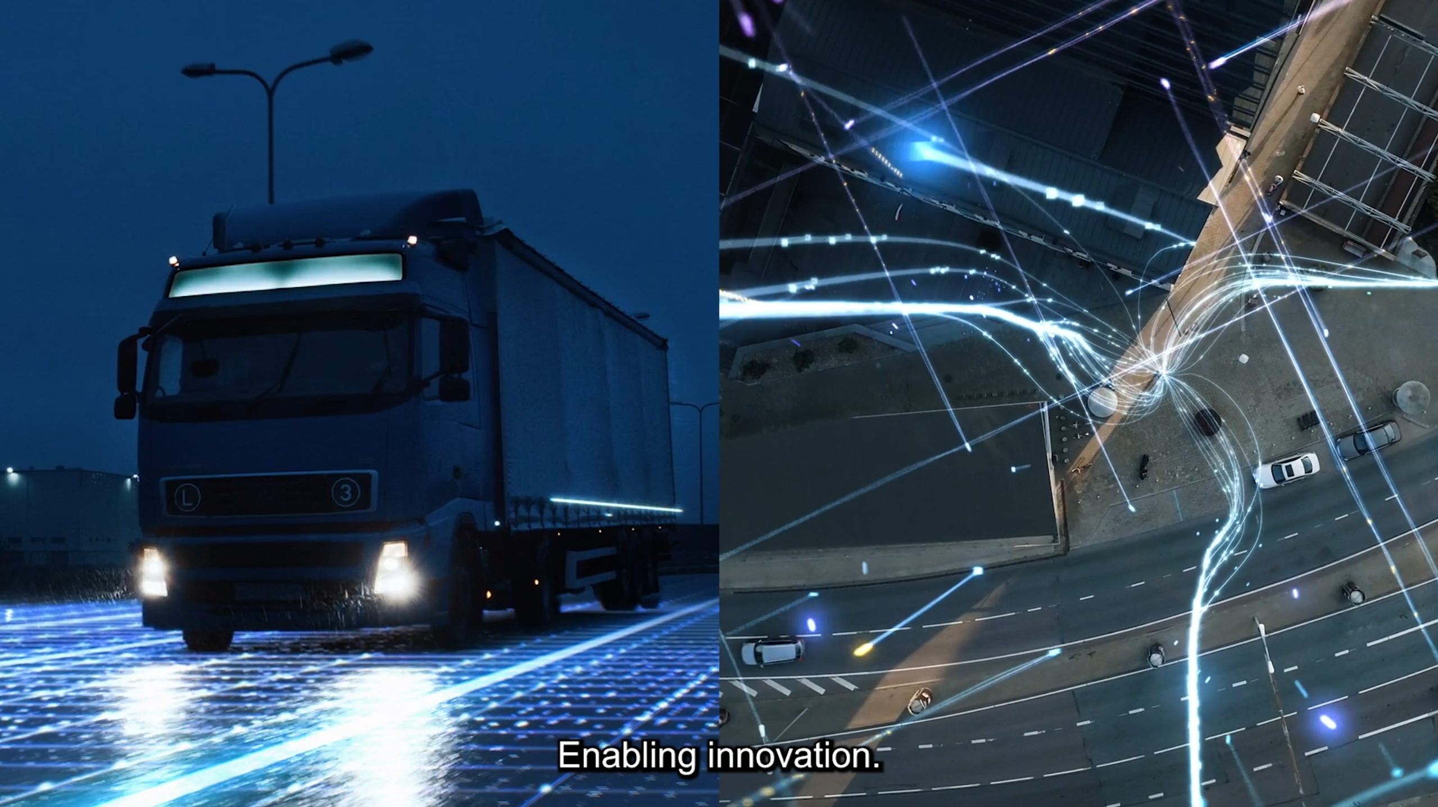
AI for Mobility Sizzle
A leading technology company wanted an innovative way to introduce its new cloud and AI-powered solutions for automotive, travel, transportation, and logistics. They turned to Affirma to create a short video to drive the message home.
Our Work
Worked closely with the client to grasp the content, offer guidance, and formulate video production timelines for the video
Tweaked the provided script to match the client's goals and vision
Selected b-roll footage that aligned with the client’s products and services
Finalized the video with engaging custom music, sound effects, and text animations
Provided closed-captions and audio descriptive files to be used with compatible video players meeting client's Accessibility Conformance standards
The Result
The video now serves as an important tool in the client's sales and marketing toolkit

